Slide 1
Data Warehouse Schemas

Slide 2
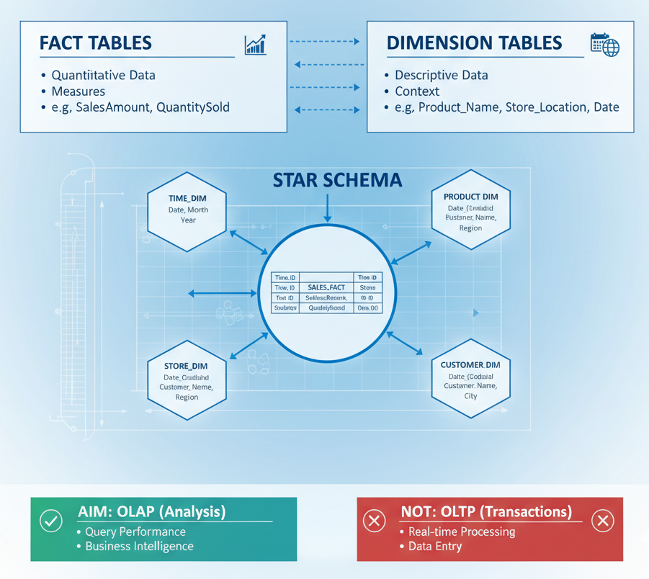
What is a Data Warehouse Schema?
A schema is the logical blueprint of the data warehouse. It defines how data is organized, stored, and related.
Aim: To structure data for optimal query performance and analysis (OLAP), not for transaction processing (OLTP).
Key Components:
Fact Tables: Store quantitative, numeric data (the "measures" or "what" you are tracking, like SalesAmount, QuantitySold).
Dimension Tables: Store descriptive, attribute-based data (the "context" or "who, what, where, when, why," like Product_Name, Store_Location, Date).

Slide 3
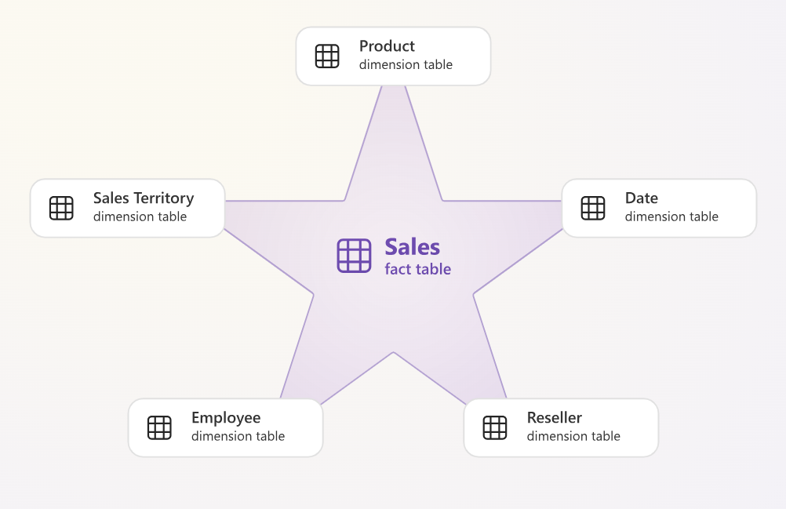
Types of Schema
Star Schema
The simplest and most common schema. It consists of a
central fact table surrounded by single, denormalized
dimension tables.
Analogy: A star, with the fact table at the center and the
dimension tables as its points.
Key Characteristics:
Structure: Simple. Each dimension is a single table.
Keys: The fact table contains foreign keys linking directly to each dimension's primary key.
Data Redundancy: High. (e.g., the "Electronics" category name is repeated for every product in that category).
Joins: Simple, one-level joins between the fact table and any dimension.
Performance: Optimized for query speed.

Slide 4
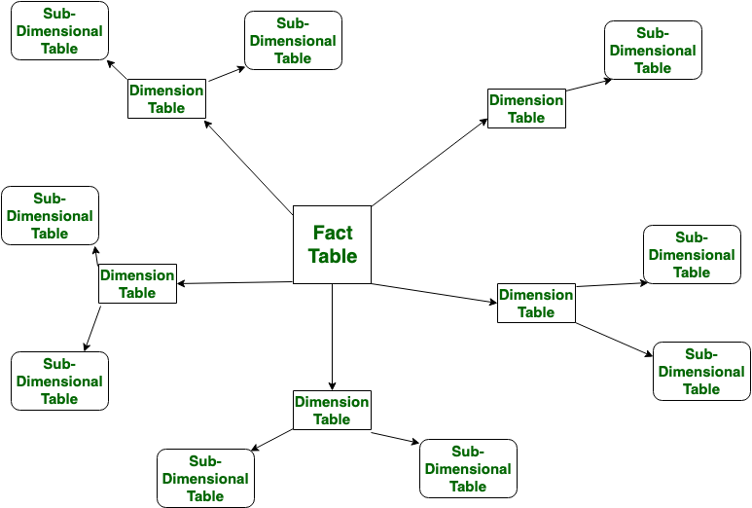
Types of Schema
Snowflake Schema
An extension of the star schema where the
dimension tables are normalized into multiple,
related lookup tables.
Analogy: The "points" of the star are split into
finer crystals, resembling a snowflake.
Key Characteristics:
Structure: More complex. A single dimension is broken into a hierarchy of tables.
Example: Dim_Product might be normalized into Dim_Product (product info), Dim_Subcategory, and Dim_Category.
Data Redundancy: Low. (e.g., the "Electronics" category name is stored only once).
Joins: Complex, multi-level joins are required.
Performance: Optimized for storage space.

Slide 5
Star vs. Snowflake
A comparison table is highly effective here.
Feature | Star Schema | Snowflake Schema
Normalization | Denormalized | Normalized
Structure | Simple, flat | Complex, hierarchical
Data Redundancy | High (data is repeated) | Low (data is stored once)
Storage Space | Uses more disk space | More space-efficient
Query Speed | Faster (fewer, simpler joins) | Slower (more, complex joins)
Maintenance | Easier to load and maintain | More complex (more tables to manage)

Slide 6
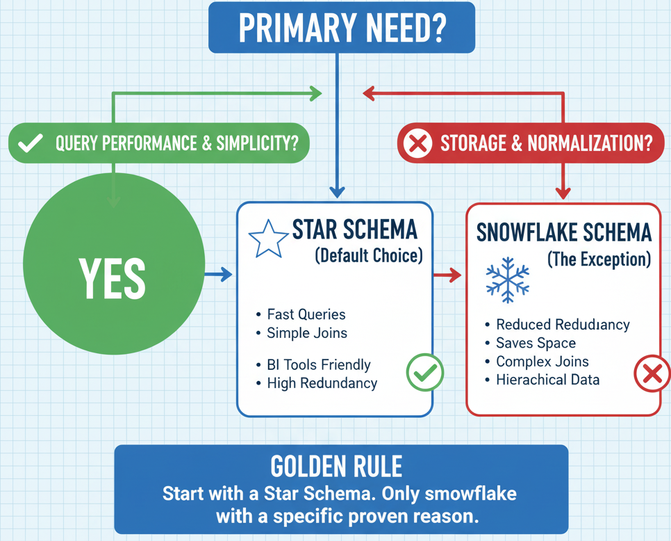
When to Use Which Schema?
Use a STAR Schema (The Default Choice) when:
Query performance is the number one priority.
You are using modern BI tools (Power BI, Tableau, etc.) which are highly optimized for star schemas.
Clarity and simplicity are valued.
Storage cost is not a primary constraint.
This is the industry standard and recommended starting point for >90% of use cases.
Use a SNOWFLAKE Schema (The Exception) when:
Storage space is a critical constraint (e.g., cloud cost optimization).
You have extremely large dimension tables (e.g., a Dim_Customer table with 100 million rows) where redundancy becomes a major cost.
You have complex, multi-level hierarchies that must be maintained.

Slide 7
Conclusion
Star Schema prioritizes simplicity and speed. It's the standard for BI and reporting.
Snowflake Schema prioritizes storage and normalization. It adds complexity and should be used sparingly.
Golden Rule:
"Start with a Star Schema. Only snowflake when you have a specific, proven, and measured reason to do so."
Final Point: The "best" schema is the one that meets your specific business needs for performance, cost, and maintainability.

Slide 8
Fact and Dimension Tables

Slide 9
Introduction
Before we dive in, let's use a simple analogy: Reporting on a Football Game.
If you wanted to describe what happened, you'd list the events:
Goal scored
Foul committed
Corner kick taken
Shot on target
These events are your FACTS. They are the numerical measurements of the game.
But these facts are meaningless without context. Who scored? When did they score? Which team committed the foul?
Player: Ronaldo
Team: Portugal
Time: 88th minute
Opponent: Spain
This descriptive context is your DIMENSIONS.
In a data warehouse, we do the same thing. We separate the measurements (Facts) from the context (Dimensions).

Slide 10
What is a Fact Table?
A fact table stores the numerical measurements of a business process. It records what happened.
Main Purpose: To store the quantitative data you want to analyze.
Nickname: The "Table of Numbers."
Content:
Measures: These are the numbers themselves. They are the data you want to sum, average, count, etc.
Examples: SalesAmount, QuantitySold, UnitCost, TotalBalance
Foreign Keys: These are numeric keys that connect the fact table to the dimension tables. They provide the context for the measures.
Examples: ProductID, TimeID, CustomerID, StoreID

Slide 11
Characteristics of a Fact Table
Fact tables have a distinct shape and set of properties.
Deep (Many Rows): They are the largest tables in your warehouse. A fact table might have billions of rows, with one row for every event (e.g., every single item sold).
Narrow (Few Columns): They only contain the numeric measures and the foreign keys. They don't store descriptive text.
Grow Quickly: A new row is added every time a business event occurs (e.g., every sale).
Grain: The "grain" defines what a single row represents (e.g., "one line item on a sales receipt").

Slide 12
What is a Dimension Table?
A dimension table stores the descriptive attributes that provide context to your facts. It describes the who, what, when, where, and why of your data.
Main Purpose: To filter, group, and label your data. These tables provide the "group by" fields in your reports.
Nickname: The "Table of Words."
Content:
Primary Key (Surrogate Key): A single, unique ID column (e.t., ProductID) that identifies each row. This key is used to link to the fact table.
Descriptive Attributes: These are the textual descriptions.
Examples: ProductName, ProductBrand, Category,a CustomerName, City, State, MonthName, DayOfWeek

Slide 13
Characteristics of a Dimension Table
Dimension tables have the opposite shape of fact tables.
Wide (Many Columns): They are designed to be very descriptive, so they often have many columns (e.g., 50-100 attributes for a single Product dimension).
Shallow (Few Rows): They only have one row for each unique entity (e.g., one row for each product, one row for each customer). They are much smaller than fact tables.
Grow Slowly: New rows are only added when a new entity is created (e.g., you start selling a new product).
Denormalized: They are often "flattened" to include redundant information (like Category and SubCategory) in the same table. This makes querying faster and simpler.

Slide 14
How They Work Together: The Star Schema
When you combine one central fact table with its surrounding dimension tables, you create a Star Schema.
The Fact Table is the center of the star.
The Dimension Tables are the points of the star.
They are connected by the keys:
The Product dimension's primary key ProductID...
...links to the ProductID foreign key in the SalesFact table.
This simple, clean design is the most common and efficient way to organize a data warehouse for reporting and analysis.

Slide 15
Summary
Feature | Fact Table | Dimension Table
Purpose | Stores measurements (metrics) | Stores context (attributes)
Content | Numeric measures, Foreign keys | Textual descriptions, Primary key
Nickname | "Table of Numbers" | "Table of Words"
Shape | Deep (billions of rows) Narrow (few columns) | Shallow (thousands of rows) Wide (many columns)
Example Data | SalesAmount, QuantitySold | ProductName, CustomerName
Analogy | The events of a game (goal) | The details of the event (who, when)

Slide 16
Types of Dimensions

Slide 17
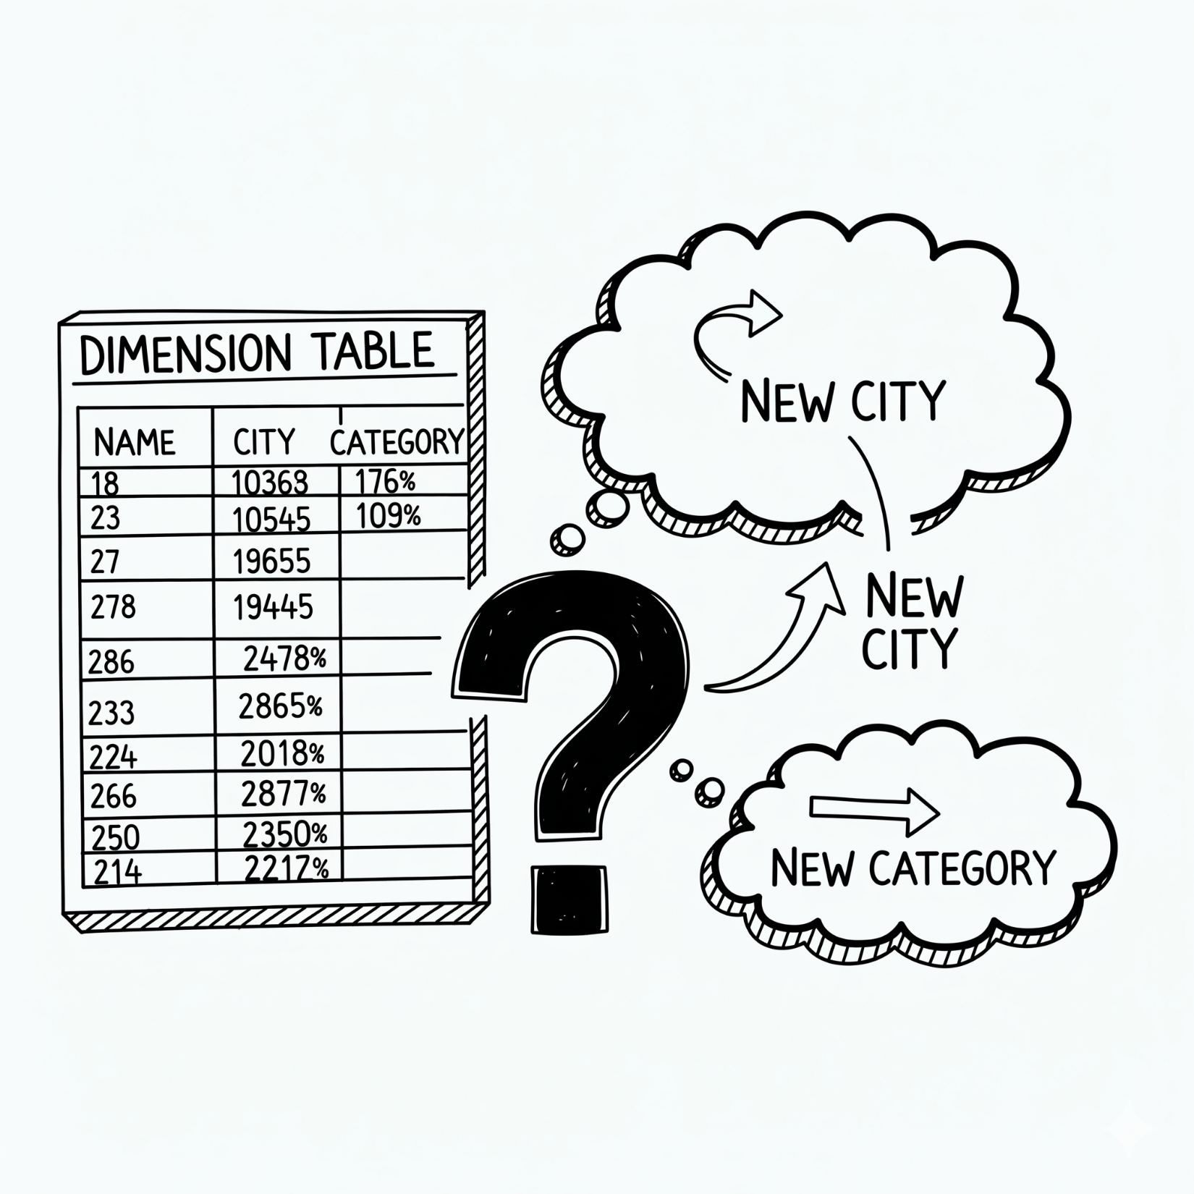
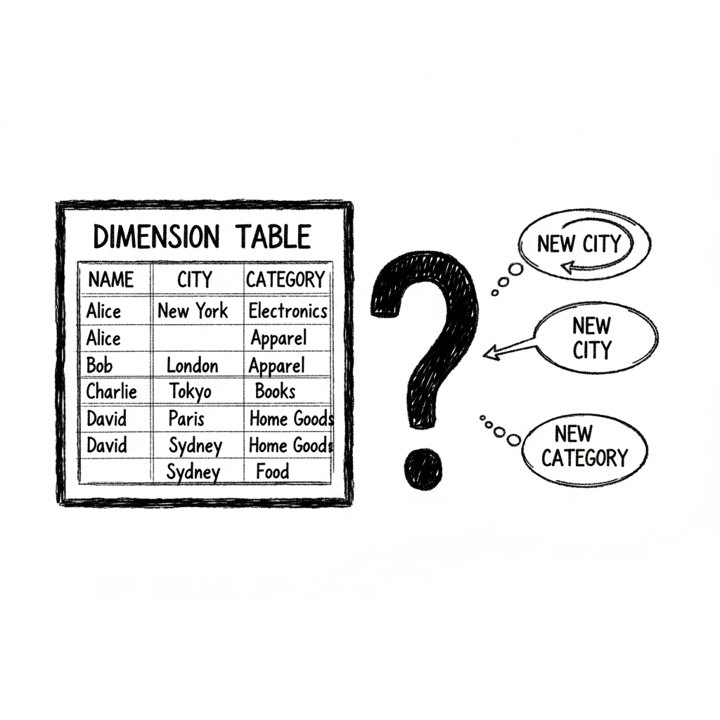
What We Already Know
Dimension Tables provide the "who, what, when, where, and why" for our data.
They contain the descriptive attributes (like ProductName or CustomerName) that we use to filter and group.
But what happens when this information changes?
What if a customer moves to a new city?
What if a product is moved to a new category?
And are all dimensions the same?
Can we reuse a dimension?
What if our dimension is just a single number?

Slide 18
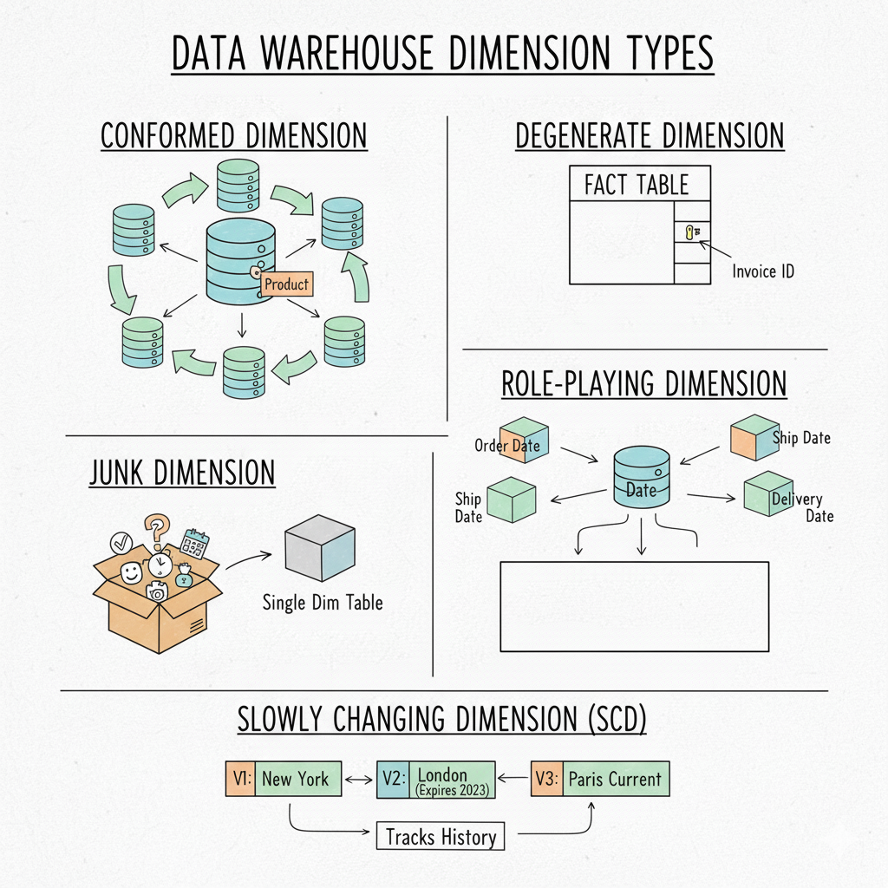
Types of Dimensions
Major Types of Dimensions in a Data Warehouse
Conformed Dimension
Degenerate Dimension
Junk Dimension
Role-playing Dimension
Static Dimension
Slowly Changing Dimension

Slide 19
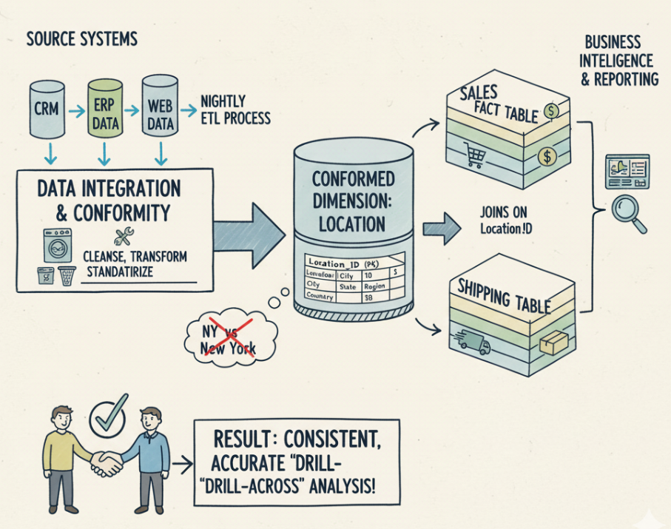
Types of Dimensions
1. Conformed Dimension
A Conformed Dimension is a standardized dimension table shared across multiple fact tables. It ensures consistent definitions for key data (like Dates, Products, or Locations) across the organization.
Why is it needed?
Without it, departments might use different labels or definitions (“NY” vs. “New York”), making cross-department reporting inaccurate. A conformed dimension forces a single, agreed-upon version of the data.
Example: The "Location" Dimension
Imagine you have two business processes:
Sales Fact Table: Tracks revenue.
Shipping Fact Table: Tracks delivery costs.
If you use a Conformed Location Dimension:
Both the Sales team and Shipping team share the exact same ID for "New York."
Result: You can easily generate a report comparing Revenue vs. Shipping Costs for New York because the system knows it is the same place.

Slide 20
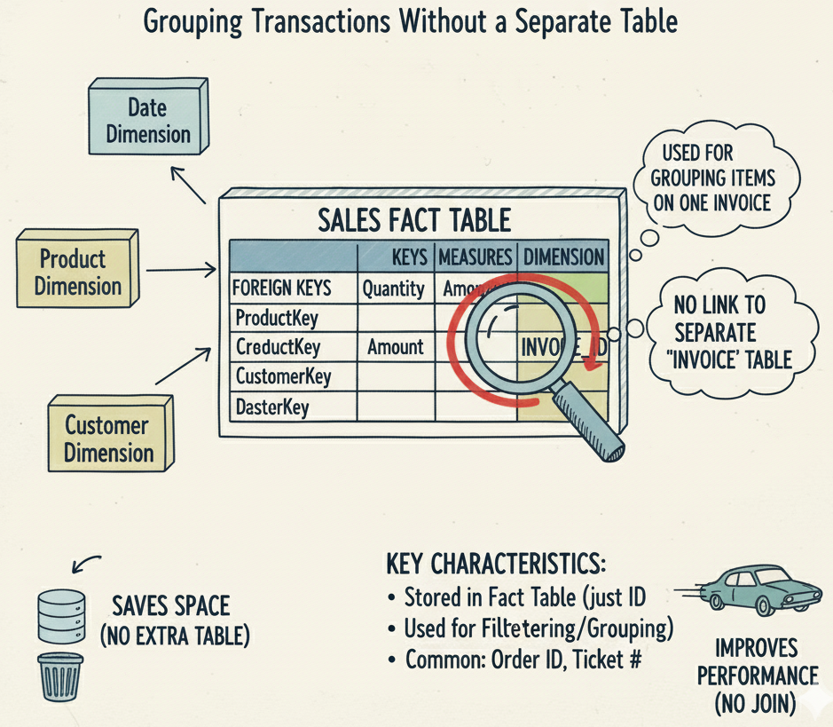
Types of Dimensions
2. Degenerate Dimension
It is a dimension key that is stored directly in the Fact Table, rather than linking to a separate Dimension table.
It acts like a dimension (used for grouping or filtering) but sits inside the fact table alongside the numerical measures.
Why do we do this?
We use it for unique identifiers that have no other attributes (no size, color, or description). Since there is no extra information to store about an "Invoice ID" other than the number itself, creating a separate table for it would be a waste of space and performance.
Example: Invoice Number
In a Sales Fact table, you usually see:
Foreign Keys: Customer_ID, Product_ID (Link to other tables).
Measures: Quantity, Amount (Math numbers).
Degenerate Dimension: Invoice_Number.
The Invoice Number uniquely identifies the transaction and lets you group all
items on the same invoice, but it doesn’t link to any separate table —
it stays directly in the fact table.
Other Common Examples: Order ID, Transaction ID, Ticket Number.
Filtering

Slide 21
Types of Dimensions
3. Junk Dimension
What is a Junk Dimension?
A Junk Dimension is a dimension table that groups together several low-cardinality (few distinct values), unrelated attributes that don't naturally fit into your main dimensions (like Customer or Product).
Instead of having 10 separate columns in your Fact Table for every little "Yes/No" question or status flag, you combine them all into one single dimension table. This keeps your Fact Table slim and efficient.
Example: A Grocery Store Checkout
Imagine you are analyzing grocery sales. For every transaction, there are small details that don't fit into "Product" or "Store":
Bag Type: Paper, Plastic, or Reusable.
Receipt Type: Printed or E-mail.
Payment Type: Cash or Card.

Slide 22
Types of Dimensions
Without a Junk Dimension (The "Fat" Fact Table): Your Fact Table looks cluttered. It stores text strings for every single sale:
Order_ID | Bag_Type | Receipt_Type | Pay_Type | Total_Amount
101 | Plastic | Email | Card | $50.00
102 | Paper | Print | Cash | $12.50
With a Junk Dimension (The Solution): You create a Dim_Checkout_Profile (The Junk Dimension) containing every possible combination of those three attributes.
Profile_ID | Bag_Type | Receipt_Type | Pay_Type
1 | Plastic | Email | Card
2 | Paper | Print | Cash
... | ... | ... | ...
Now, your Fact Table is clean and uses a simple number key:
Order_ID | Profile_ID | Total_Amount
101 | 1 | $50.00
102 | 2 | $12.50

Slide 23
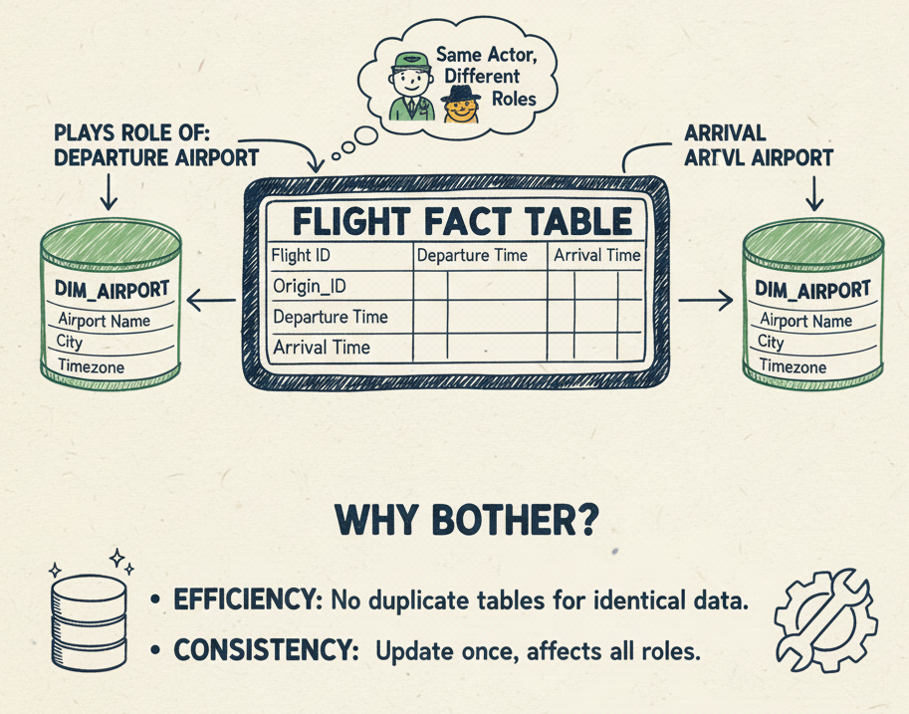
Types of Dimensions
4. Role Playing Dimension
A Role-Playing Dimension is one physical dimension table used multiple times in the same fact table, with each use representing a different context. The data doesn’t change—only the role it plays.
Analogy: One actor plays multiple characters. Same actor, different roles.
Same table, different meanings.
Example – Airline Flights: A flight fact needs two airports: Origin and Destination. Both Origin_ID and Dest_ID point to the same Dim_Airport table. Joined on Origin_ID, it represents the departure airport; joined on Dest_ID, it represents the arrival airport.
Why bother?
Efficiency: No duplicate tables for identical data.
Consistency: Update an airport once, and all roles stay aligned.
Common cases:
Dates: Order Date, Ship Date, Delivery Date
Employees: Manager, Sales Rep
ARRIVAL AIRPORT

Slide 24
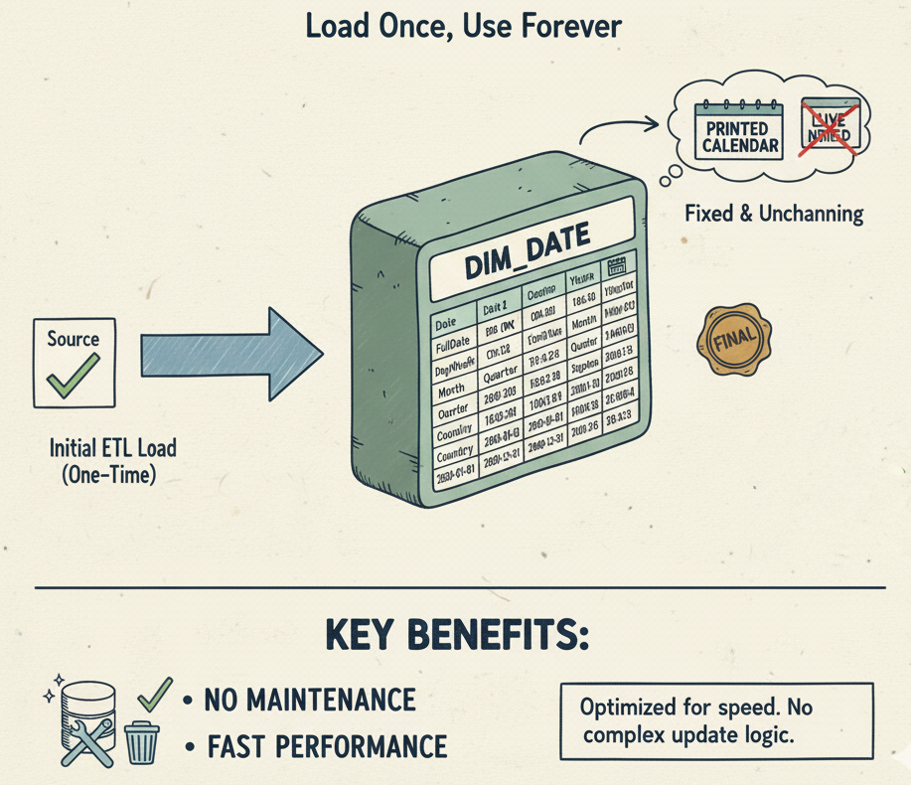
Types of Dimensions
5. Static Dimension
A Static Dimension is a dimension whose data never changes (or changes so rarely that it’s treated as permanent). Once loaded, it requires no ongoing updates.
Analogy: A printed calendar: fixed and unchanging — unlike a constantly updating news feed.
Main Example – Date Dimension: Dim_Date is the classic static dimension. Dates, weekdays, quarters, and
holidays don’t change, so the table can be pre-built for decades.
Other examples:
Country/State codes (ISO codes)
Demographic categories (gender, age bands)
Fixed status codes (Open, Closed, Pending)
Why it matters:
No maintenance: Load once and leave it.
Fast performance: Unchanging data is easy for databases to optimize.

Slide 25
Types of Dimensions
6. Slowly Changing Dimensions (SCD)
Slowly Changing Dimensions (SCD) are techniques used in data warehousing to manage and track changes in dimension data (e.g., customer, product, employee) over time. They ensure historical accuracy and consistent reporting even when source data evolves.
In analytical systems, dimension attributes (like address, name, or department) rarely change — but when they do, it’s critical to decide whether to:
Overwrite the old value, or
Preserve historical versions for trend analysis.
Type | Method | History
Type 1 – Overwrite | Replace old data | No
Type 2 – Add Row | Create new record with start/end dates | Full
Type 3 – Add Column | Add column for previous value | Partial
Type 4 – Historical Table | Separate table for history | Full
Type 6 – Hybrid (1+2+3) | Combine overwriting + new row + new column | Full

Slide 26
Types of Facts

Slide 27
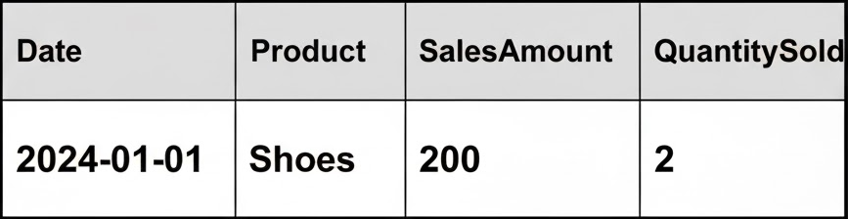
What is a “Fact”?
A Fact is a numerical measurement stored in a Fact Table.
The entire purpose of a data warehouse is to aggregate these facts (using SUM, AVG, COUNT, MIN, MAX).
The Crucial Question: How can we aggregate them?
Can we sum SalesAmount across time? Yes.
Can we sum InventoryCount across time? No, that doesn't make sense.
This property is called Additivity. Understanding it is essential for building correct reports and preventing major errors.
Examples: SalesAmount, QuantitySold, InventoryCount, Temperature.

Slide 28
Types of Facts
Additive Fact:
An additive fact is a measure that can be meaningfully summed (or aggregated) across any and all dimensions.
The Litmus Test: Does it make business sense to SUM() this number, no matter how I group it?
Example: SalesAmount
Sum SalesAmount by Customer? Yes. (Total sales for that customer)
Sum SalesAmount by Product? Yes. (Total sales for that product)
Sum SalesAmount by Date? Yes. (Total sales for that day)
Why they are great: They are the most flexible and useful. Most facts in your data warehouse should be additive.
Other Examples: QuantitySold, CostOfGoodsSold, WebPageViews, TransactionCount.

Slide 29
Types of Facts
Semi-additive Fact
A semi-additive fact is a measure that can be summed across some dimensions, but not all.
The Classic Example: InventoryBalance
This fact represents a "snapshot" in time.
Can you sum InventoryBalance by Warehouse? Yes. (Gives you total inventory across all warehouses at that moment).
Can you sum InventoryBalance by Product? Yes. (Gives you total units of that product at that moment).
Can you sum InventoryBalance by Date? NO.
(Inventory on Monday was 100. Inventory on Tuesday was 100. The "total inventory" for Monday and Tuesday is not 200. That number is meaningless.)
How to use them: For dimensions they can't be summed across (like Time), you must use other aggregations: AVG(), MIN(), MAX(), or LAST().
"What was the average inventory in Q1?" (Meaningful)
"What was the end-of-period inventory for Q1?" (Meaningful)
Other Examples: AccountBalance, Headcount, RoomTemperature (you would average, not sum).

Slide 30
Types of Facts
Non-additive Fact
A non-additive fact is a measure that cannot be meaningfully summed across any dimension.
Why? They are usually pre-calculated ratios, percentages, or other complex values.
Example: ProfitMargin (which is Profit / Sales)
You have two products:
Product A: 50% margin
Product B: 10% margin
What is the total margin for the company? It is not 60% (50% + 10%).
How to handle them: This is critical. You must store the components and calculate the ratio in the BI tool.
Bad Design: Storing ProfitMargin in the fact table.
Good Design: Store SalesAmount and ProfitAmount (which are additive) in the fact table.
In your report, you calculate: SUM(ProfitAmount) / SUM(SalesAmount). This gives the correct, weighted margin.
Other Examples: AverageSellingPrice, any percentage, ratios, Temperature (unless averaging).

Slide 31
Summary
Type | Additive | Semi-Additive | Non-Additive
Definition | Can be summed across ALL dimensions. | Can be summed across SOME dimensions. | CANNOT be summed across any dimension.
Example | SalesAmount QuantitySold | InventoryBalance AccountBalance | ProfitMargin (%) AveragePrice
How to Use | SUM() freely. | SUM() across some dims. AVG(), LAST() across others (like Time). | Do not SUM(). <H> Store the components (e.g., Profit, Sales) and calculate the ratio in the report.

Slide 32
Types of Fact Tables

Slide 33
Introduction
A fact table stores the numeric measurements from a business process.
The Question: Is every business process a simple, one-time event?
"A customer bought a product." — This is a simple event.
"What was our inventory at the end of every day last month?" — This is a recurring state.
"How long did it take for an order to be shipped after it was placed?" — This is a process lifecycle.
We need different fact table structures to answer these different types of questions. The three main types are:
Transactional
Periodic Snapshot
Accumulating Snapshot

Slide 34
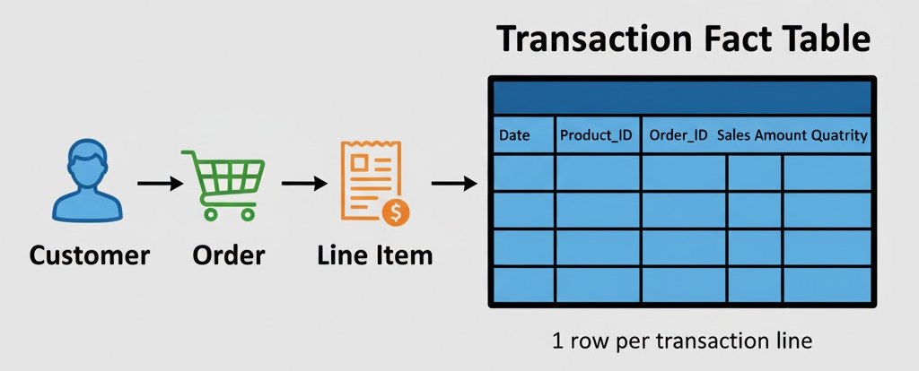
Transactional Fact Table
Definition: Records one row for every single, low-level event (a transaction) as it occurs.
Grain: The grain is "one row per transaction" or "one row per transaction line item." This is the most atomic (lowest) level of detail possible.
How it's Loaded: New rows are constantly inserted as new events happen. Rows are (almost) never updated.
Measures: The facts are typically fully additive (e.g., SalesAmount, QuantitySold).
Example:
A SalesFact table where each row is one product on one receipt.
A WebLogFact table where each row is one click on a website.
Best for: "What happened?" analysis. It provides maximum flexibility for "slicing and dicing" detailed data.

Slide 35
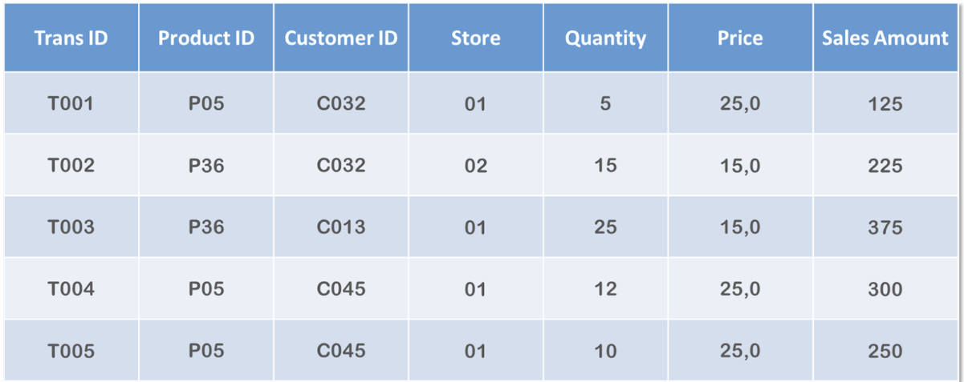
Example - Transactional Fact Table
Each row represents one unique sales transaction (identified by Trans ID like T001, T002).
Trans ID works as the unique event identifier — no duplicates.
Product ID shows which product was sold (e.g., P05, P36).
Customer ID identifies the buyer (e.g., C032, C045).
Quantity = number of units purchased in that transaction.
Price = price per unit for that product.
Sales Amount is calculated as Quantity × Price
Example: T001 → 5 × 25 = 125
Store column indicates the store where the sale occurred (01 or 02).
Same customer or product appearing again = new transaction, not an update.
Perfect example of a transactional fact table: each event is stored once with detailed measures (Quantity, Sales Amount) and foreign keys (Product, Customer, Store).

Slide 36
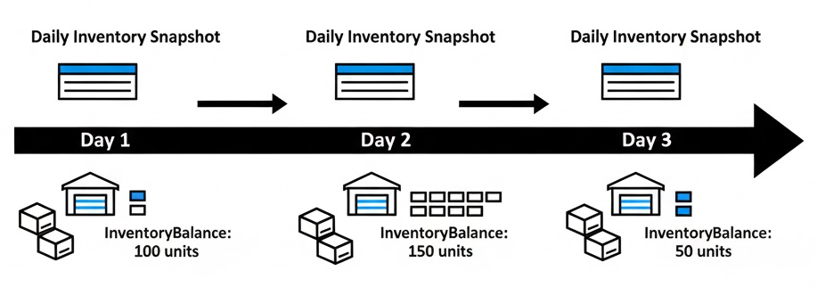
Periodic Snapshot Fact Table
This fact table provides a "snapshot" or "picture" of a state at a regular, predictable interval.
Definition: Records a row for a subject (e.g., a product, an account) at the end of a specific period (e.g., day, week, month).
Grain: The grain is "one row per [subject] per [period]."
How it's Loaded: A new set of rows is inserted at the end of each period (e.g., a batch job runs at midnight to capture all inventory levels).
Measures: The facts are often semi-additive (e.g., InventoryBalance, AccountBalance, Headcount).
Example:
An InventoryFact table where each row is the QuantityOnHand for one product in one warehouse at the end of each day.
Best for: "What is the status?" or "How has this trended?" analysis. It's perfect for tracking states or balances over time.

Slide 37
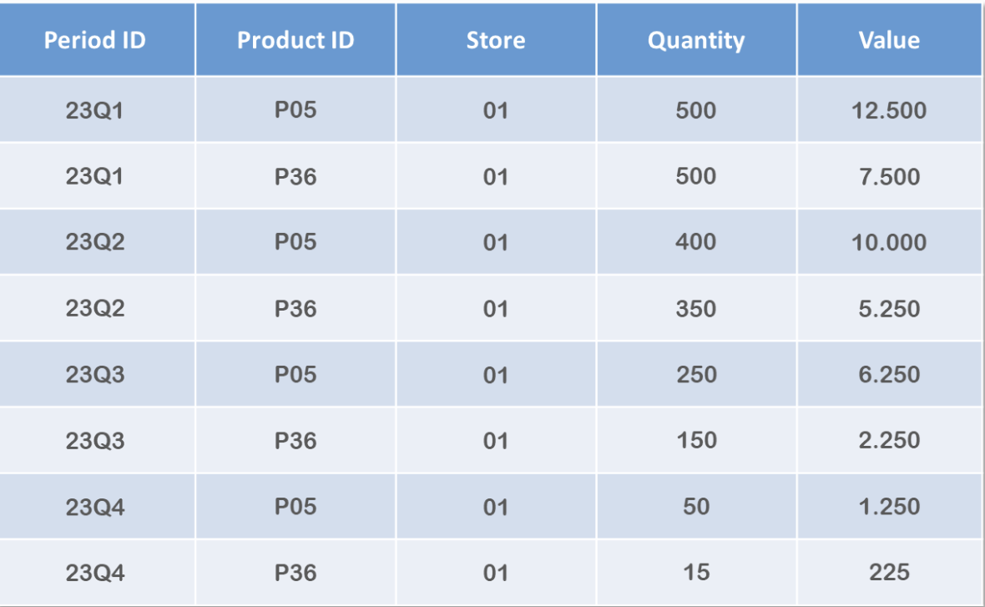
Example - Periodic Snapshot Fact Table
Each row shows summary totals for a fixed period (Quarter → 23Q1, 23Q2, etc.).
Data is aggregated, not individual transactions.
Product ID and Store identify what and where the summary belongs to.
Quantity = total units sold in that quarter.
Value = total revenue for that product in that quarter.
One row per product per period (e.g., P05 & P36 each quarter).
Old snapshots are not updated — changes appear only in the next period.
Used to track trends over time (quarter-on-quarter performance).

Slide 38
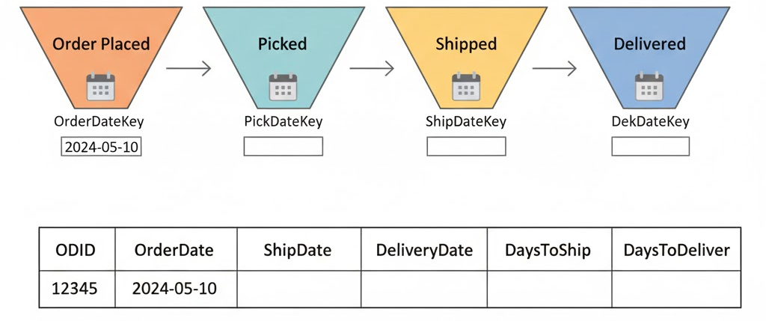
Accumulating Snapshot Fact Table
This fact table tracks the lifecycle of a process that has a clear beginning, middle, and end.
Definition: Records one row for the entire lifecycle of a subject (e.g., an order, an application). This single row is updated as the process hits key milestones.
Grain: The grain is "one row per [lifecycle]."
How it's Loaded: A row is inserted at the start of the process. It is then updated multiple times as milestones are reached.
Measures: The facts are often durations or milestone counts (e.g., DaysToShip, DaysToDeliver).
Example:
An OrderFulfillmentFact table with one row per order.
Columns: OrderDateKey, ShipDateKey (updated when shipped), DeliveryDateKey (updated when delivered), TotalDaysToShip.
Best for: "How long did it take?" or "Where are the bottlenecks?" analysis. It excels at measuring process efficiency.

Slide 39
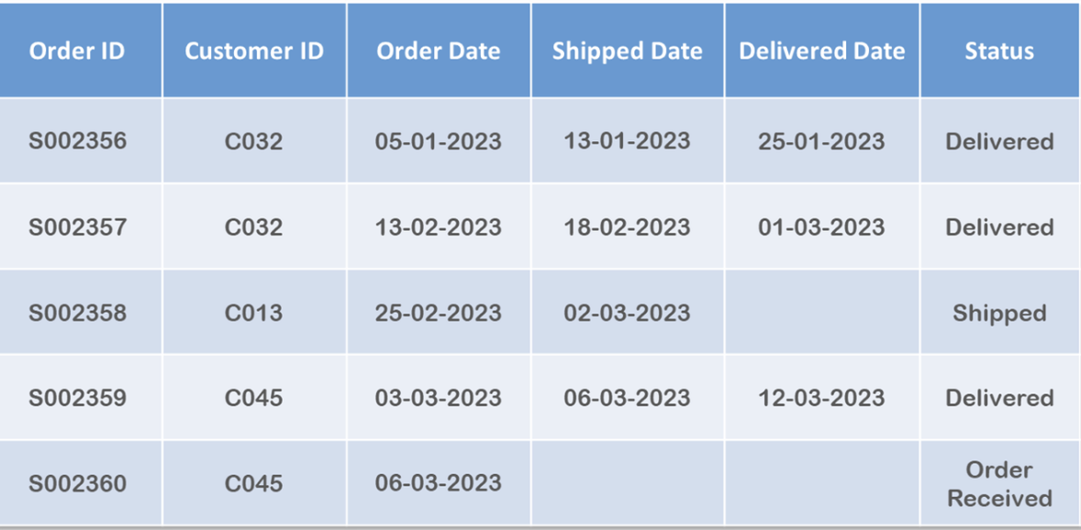
Example - Accumulating Snapshot Fact Table
Each row represents one customer order, identified by a unique Order ID.
Customer ID shows who placed the order.
Order Date, Shipped Date, and Delivered Date track the full order journey.
Status shows the current stage of the order (Delivered, Shipped, Order Received).
This kind of table helps analyze order processing time, delivery delays, and customer activity.
Useful for tracking how long each step takes:
Order → Shipment → Delivery.

Slide 40
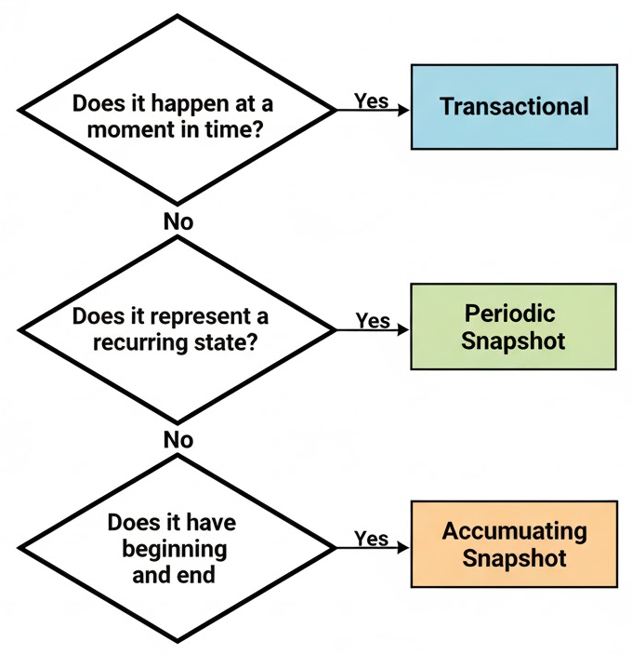
Summary
Feature | Transactional | Periodic Snapshot | Accumulating Snapshot
Grain | One row per event | One row per subject, per period | One row per process lifecycle
Example | Sales line item | Daily inventory balance | Order fulfillment
How it's Loaded | Insert only (append) | Insert in batches (at end of period) | Insert and Update (as milestones hit)
Measures | Additive (e.g., SalesAmount) | Semi-Additive (e.g., Balance) | Durations (e.g., DaysToShip)
Key Question | "What happened?" | "What's the status over time?" | "How long did it take?"

Slide 41
Factless Fact Table

Slide 42
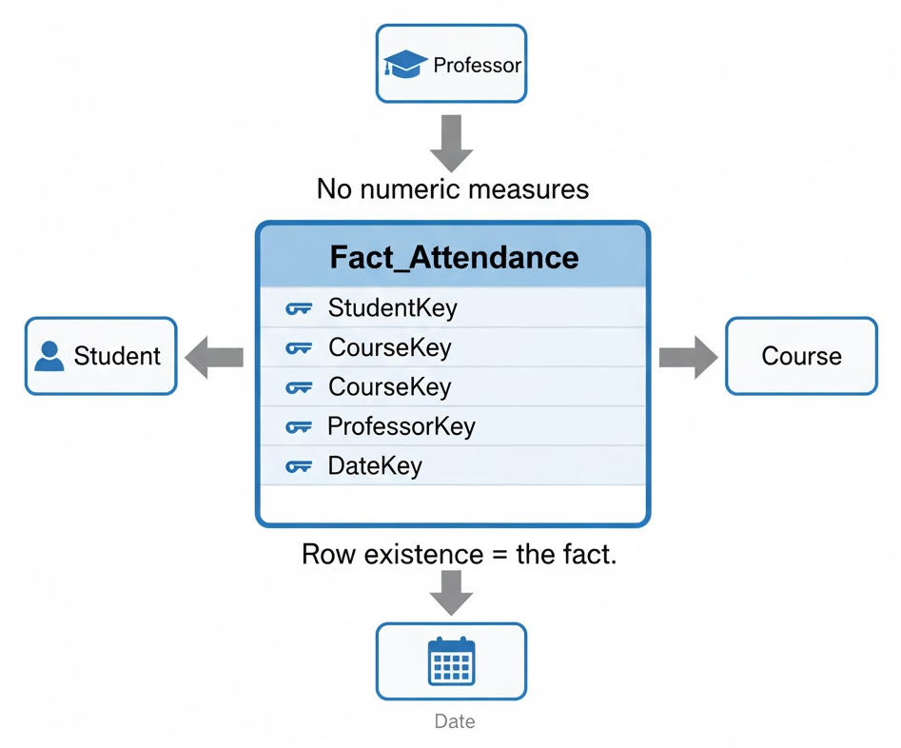
What is a Factless Fact Table?
A factless fact table is a fact table that does not contain any numeric measures.
It's a table that consists only of foreign keys that link to the dimension tables.
The Question: Why would you build this? If there are no numbers to SUM() or AVG(), what's the point?
The Answer: The table itself is recording a fact. The existence of a row is the "fact." It's used to track events and relationships that don't have a quantitative measurement.
Two Main Types of Factless Fact Tables
There are two primary scenarios where you would use a factless fact table:
To Track ana Event: Recording that something happened at a specific point in time, involving specific dimensions.
To Track Coverage (or "What Didn't Happen"): Creating a table that defines all the possible relationships, which you can then compare against what actually happened.

Slide 43
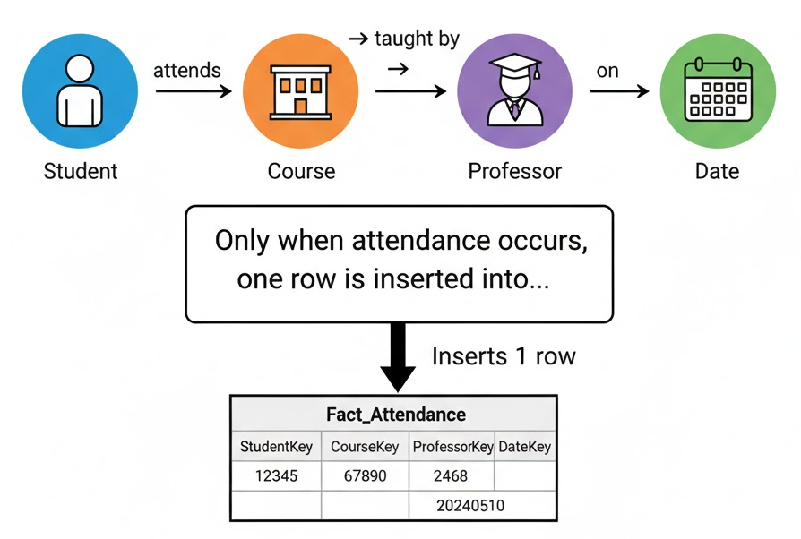
Type 1: Tracking an Event
This is the most common and simple type. The table simply records that an event occurred.
Business Question: "Which students attended which lectures on which days?"
There is no number (measure) for "attendance." The student was either there (a row exists) or not (no row exists).
The Model: You create a Fact_Attendance table.
Keys: StudentKey, CourseKey, ProfessorKey, DateKey
That's it! There are no measures.
How to Use It: You analyze it using COUNT().
"How many students attended 'History 101' on Monday?" SELECT COUNT(*) FROM Fact_Attendance...
"List all students who attended any class in October." SELECT DISTINCT StudentName FROM Dim_Student JOIN Fact_Attendance...

Slide 44
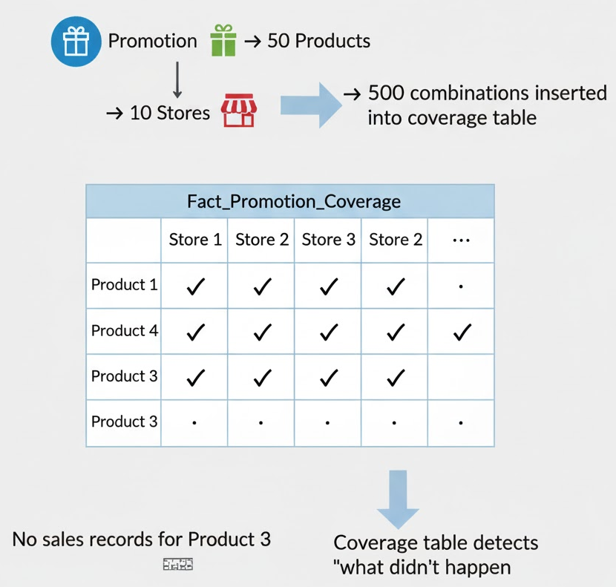
Type 2: Tracking Coverage
This is a more advanced technique used to find out what didn't happen.
Business Question: "We ran a promotion for 50 products in 10 stores. Which products didn't sell at all in which stores during the promotion?"
The Problem: Your SalesFact table only has rows for products that did sell. You can't use it to find what's missing.
The Solution: You create a factless "coverage" table (e.g., Fact_PromotionCoverage).
When the promotion starts, you populate this table with one row for every possible combination of product and store involved in the promotion.
(e.g., 50 products x 10 stores = 500 rows)
Keys: PromotionKey, ProductKey, StoreKey
How to Use It:
You can now query this table. To find the products that didn't sell, you find the rows in Fact_PromotionCoverage that have no matching rows in the SalesFact table.
This is a powerful way to analyze "negative" space in your business.

Slide 45
Summary
Feature | Normal Fact Table | Factless Fact Table
Purpose | Records measurements (how much?) | Records events or relationships (what happened?)
Measures | Yes (e.g., SalesAmount) | No (has no measures)
Content | Keys + Measures | Keys Only
Example | SalesFact | StudentAttendanceFact (Type 1) PromotionCoverageFact (Type 2)
Analysis | SUM(), AVG() | COUNT(), JOIN / NOT EXISTS

Slide 46
Surrogate Keys and Their Use in DW

Slide 47
What Are We Trying to Do?
We know we need to link a Fact Table to a Dimension Table.
SalesFact needs to link to Product dimension.
The Question: How do we make that link? What key do we use?
We have two choices:
Natural Key: The key used in the original source system (e.g., SKU-5001, EmployeeID-901, SSN-XXX-XX-XXXX).
Surrogate Key: A new, meaningless, unique key we create just for the data warehouse.

Slide 48
What is a Natural Key?
A natural key (or "business key") is the identifier for an object in the real world or in the source operational system.
Examples:
ProductSKU
EmployeeID
CustomerEmail
SocialSecurityNumber
OrderNumber
Characteristics:
They have business meaning.
They are not controlled by the data warehouse. They are controlled by external systems.
The Problem: Using them to link your tables is a very bad idea.

Slide 49
What is a Surrogate Key?
A surrogate key is an artificial key. It is a unique, numeric integer created by the data warehouse when a new row is loaded into a dimension table.
Examples: 1, 2, 3, 4, 5...
Characteristics:
Simple: Just a small, simple integer.
Unique: It's the primary key of the dimension table (e.g., ProductKey, CustomerKey).
No Business Meaning: The number 101 means nothing outside the data warehouse.
Controlled by YOU: The data warehouse assigns it and manages it.

Slide 50
Why We MUST Use Surrogate Keys
Using natural keys as your primary links will break your data warehouse. Here's why surrogate keys are essential:
Reason 1: Decoupling from Source Systems
Problem: What if the business decides to change its ProductSKU format? Or, what if you acquire a company that uses a conflicting SKU system?
Solution: With a surrogate key, it doesn't matter. The natural key (SKU-5001) is just another attribute in your dimension. The surrogate key (ProductKey: 123) never changes. Your fact table, with its billions of rows, is linked to 123 and is completely protected from the change.
Reason 2: Enabling History (SCD Type 2)
This is the most important reason.
Recap: With Slowly Changing Dimensions (SCD) Type 2, we "Add a New Row" to track history.
Example:
CustomerKey: 101, Name: Jane, City: New York, NaturalKey: 900A
Jane moves to London. We add a new row:
CustomerKey: 102, Name: Jane, City: London, NaturalKey: 900A
Notice the Natural Key is the same, but the Surrogate Key is different.
Result: Old facts are linked to 101 (New York). New facts are linked to 102 (London). This is impossible to do if you only use the natural key.

Slide 51
More Reasons to Use Surrogate Keys
Reason 3: Handling "Unknown" or "Missing" Keys
Problem: You get a sales record from your cash register, but the customer ID is missing.
You can't put a NULL in the fact table's key column.
Solution: You create a special row in your Customer dimension for this scenario:
CustomerKey: -1
CustomerName: Not Applicable
City: N/A
Now your fact table can safely link to CustomerKey: -1, and your queries still work.
Reason 4: Performance
Problem: Natural keys can be large and complex (e.g., ABC-5001-XYZ-99).
Solution: Surrogate keys are just simple integers (123).
Result: Your fact table, which has billions of rows and multiple key columns, is dramatically smaller.
Joins between small integers are much faster than joins between large, complex strings.

Slide 52
Summary
Feature | Natural Key (Business Key) | Surrogate Key (DW Key)
Example | SKU-5001, EmployeeID | 101, 102, 103...
Meaning | Has business meaning | Has NO business meaning
Controlled By | Source System (External) | Data Warehouse (You)
Stability | Can change, be recycled, or conflict | Never changes
Role in DW | Just another descriptive attribute | The Primary Key of the dimension and the Foreign Key in the fact table
Handles SCDs? | No | Yes (This is why we use it!)

Slide 53
Granularity in Data Warehouse Design

Slide 54
What is Granularity?
Granularity (or "the grain") is the formal definition of what a single row represents in your fact table.
It defines the lowest level of detail being stored.
Analogy: A Digital Photo
A high-granularity photo is like a low-resolution image. You can see the main subjects (e.g., "sales by month by store"), but you can't zoom in.
A low-granularity photo is like a high-resolution 4K image. You can see the finest details (e.g., "sales by individual item by second by register").
In data warehousing, "low grain" means more detail (atomic level) and "high grain" means less detail (summarized level).

Slide 55
How to Declare the Grain
The grain must be declared in a clear, specific business statement before you build anything.
Example 1: Good Grain (Low Granularity / Atomic)
"The grain of the sales fact table is one line item on a sales receipt."
Example 2: Good Grain (Higher Granularity / Summarized)
"The grain of the sales fact table is one store's total sales per day.“
The first example is far more flexible than the second. You can get daily store totals from individual line items, but you can never get line item details from a daily total.

Slide 56
Why is This the MOST Important Decision?
The grain you choose dictates everything else in your design:
It defines your fact table:
The grain statement tells you exactly what a fact row is.
(e.g., "one line item...")
It defines your dimensions:
The grain statement tells you which dimensions you need.
"one line item..." -> needs a Product dimension.
"...on a sales receipt..." -> needs a Date dimension, maybe a Transaction dimension (Degenerate), and a Customer dimension.
"...by store..." -> needs a Store dimension.
It defines the size of your warehouse:
A "daily summary" grain might be 1,000 stores x 365 days = 365,000 rows per year.
A "line item" grain might be 100 items/day x 1,000 stores x 365 days = 36,500,000 rows per year.
You must plan for this storage and performance from day one.

Slide 57
The Trade-off: Detail vs. Simplicity
You have to balance business needs with technical reality.
Low Granularity (e.g., Atomic / Line Item)
Pros:
Maximum Flexibility: You can answer any question. You can "roll up" the data to any summary level (day, week, month, category).
Deep Analysis: You can analyze the finest details, like which products are sold together.
Cons:
Huge Storage: Requires a massive amount of storage.
Slower Queries: Can be slower to query (though modern databases are very good at this).
More Complex ETL: You have to process every single transaction.
High Granularity (e.g., Summarized / Daily Total)
Pros:
Small & Fast: The database is small, and queries are extremely fast.
Simple ETL: The ETL process is simpler.
Cons:
Completely Inflexible: You cannot answer any question more detailed than the grain.
Business Failure: If your grain is "sales by day" and your boss asks, "What was our best-selling product?" you cannot answer the question.

Slide 58
The Golden Rule of Granularity
Always store data at the lowest (most atomic) grain possible.
Why?
You can always create summaries from detailed data.
You can NEVER create detail from summarized data.
Storage is cheap. Business answers are priceless. Don't let a "pre-summarized" design prevent you from answering the one question your CEO asks.
If performance becomes an issue, you can build additional summary tables (called "aggregates"), but you should always keep the atomic-level data as your foundation.

Slide 59
Fact Table Granularity

Slide 60
What is Granularity?
The Grain is the definition of what a single row in your fact table represents.
It is the lowest level of detail stored.
This is the most important design decision because it dictates your dimensions, your measures, and the business questions you can (and cannot) answer.
Declaring Your Fact Table's Grain
Your grain declaration must be precise, specific, and unambiguous.
A BAD (Vague) Grain:
"This fact table is for sales."
(Does this mean total sales? By day? By item? Who knows?)
A GOOD (Summarized) Grain:
"The grain is one row per store, per day."
(This is clear. We know the dimensions are Store and Date. We know the lowest level of detail is a single day.)
AN EVEN BETTER (Atomic) Grain:
"The grain is one row per product line item, per sales transaction."
(This is the most flexible. We know the dimensions are Product, Transaction (degenerate), Date, Store, etc.)

Slide 61
How the Grain Defines Your Fact Table
Once you have your grain, the design of your fact table becomes clear.
If your grain is: "One row per product line item, per sales transaction"
Your Dimensions are:
DateKey (for the transaction date)
ProductKey (for the product sold)
StoreKey (for the store where it was sold)
CustomerKey (for the customer who bought it)
TransactionIDKey (a degenerate dimension)
Your Facts (Measures) are:
QuantitySold
SalesAmount
UnitCost
DiscountAmount
The grain statement directly tells you what columns must be in your fact table.

